Slide 1
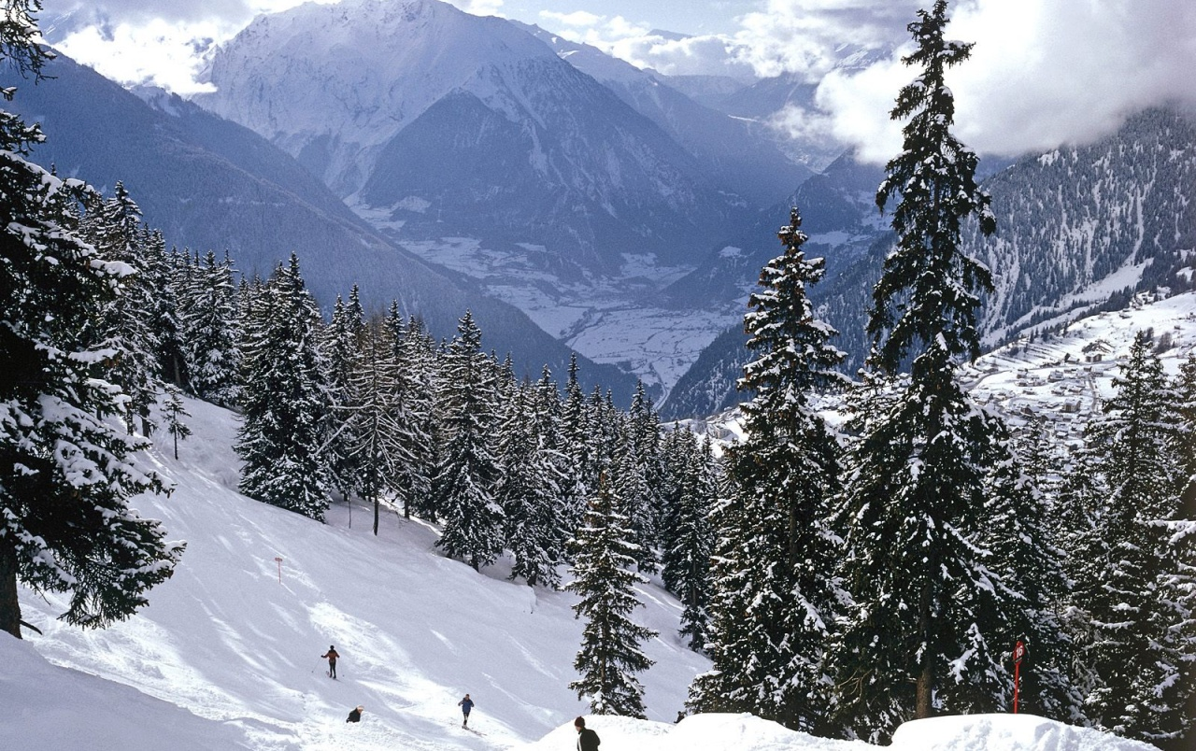
Big Mountain
Price strategy evaluation
Springboard Consulting
February 9, 2021

Slide 2
TABLE OF CONTENTS
01.
02.
03.
04.
The problem
Recommendations
Background and context
Objectives and scope
Key findings
Results and analysis
Conclusion
Most valued facilities
Performance against competitors
Summary
Next steps

Slide 3
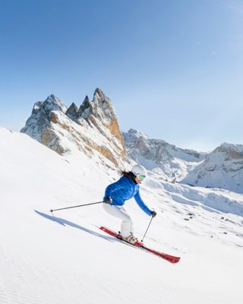
01.
THE PROBLEM

Slide 4
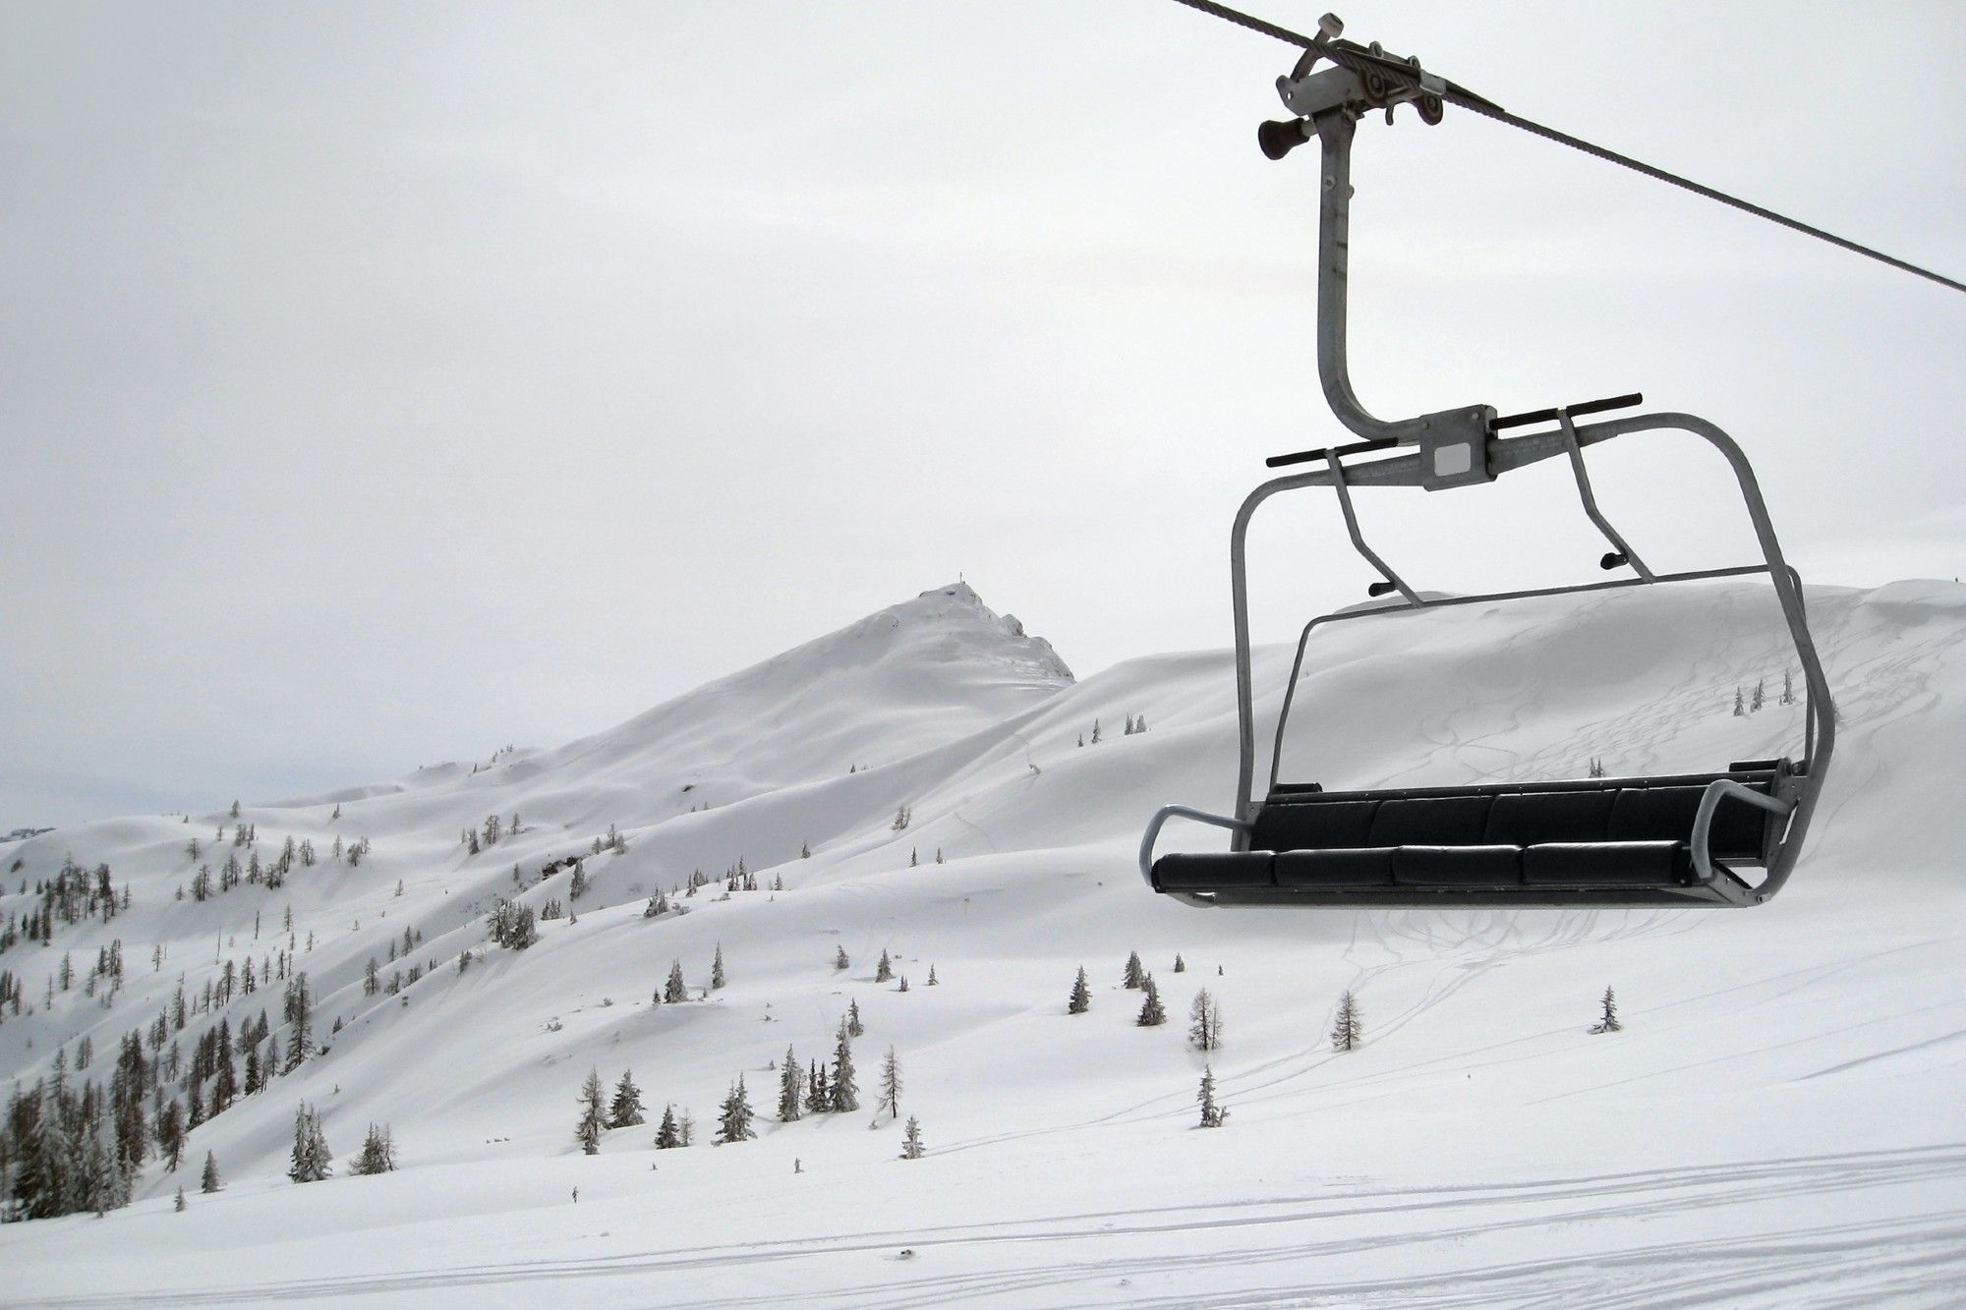
$1.54M additional operating cost this season
from recent investment in chair lift
“To what extent is Big Mountain capitalizing on its facilities through pricing? ”
“Given competitor pricing, how much can Big Mountain charge for its tickets?”
Notes:
CONTEXT

Slide 5
OBJECTIVES & SCOPE
SCOPE & LIMITATIONS
UNCOVERING INSIGHTS
Predictive modelling will be based solely on data provided (various resort parameters outlined in the Appendix). Due to missing data, only adult weekend prices will be modelled.
The approach assumes that that all other resorts are largely setting prices based on how much people value certain facilities.
To provide an insight into how important some facilities are compared to others
PREDICTIVE ANALYTICS
Guidance on how to charge customers for the value provided through facilities
SCENARIO MODELLING
To evaluate how various initiatives may affect ticket pricing
Notes:
To optimize its investment strategy - a good sense of how important some facilities are compared to others.

Slide 6

02.
RECOMMENDATIONS

Slide 7

SETTING PRICES
Price increase from current
Analysis suggests Big Mountain’s ticket prices are underpriced at $81.
As it provides more facilities than competitors in the Montana and even throughout the country, the model supports a price of $95.87 (+/- $10.39), positioning Big Mountain at the higher end of the market.
Hence, this suggests the need to adjust ticket prices to reflect the resort’s premium offering.
+34%
+18%
+6%

Slide 8
2. EVALUATING THE INITIATIVES
 | Scenarios | Findings | Recommendation
1 | Close down up to 10 of the least used runs | Closing 1 run makes no difference Closing 4 or 5 runs will have the same effect as closing 3 | Investigate option to close 1 or 5 runs
2 | Increase vertical drop (add a run to 150ft lower), add a chair lift | Supports a price increase of $1.99, resulting into c. $3.5m over the season | Investigate profitability of initiative by gathering corresponding costs
3 | As above, and add 2 acres of snow | Adding two acres of snow does not provide additional price lift | Not recommended
4 | Increase longest run by 0.2mi, add 4 acres of snow | No price difference predicted from initiative | Not recommended

Slide 9

03.
RESULTS & ANALYSIS

Slide 10
MOST VALUED FACILITIES
Rated most relevant by both models:
Skiable area
LR predicts a negative relationship to price – TBD
Fast four-person chairs
Runs on the resort
Chairlifts
Length of longest run
Area covered by snow-making machines
Vertical drop (summit to base)
Whilst one of the more important features in LR, this is less important for the RF.
LR: Linear regression model
RF: Random forest model

Slide 11
PERFORMANCE AGAINST COMPETITORS
Fast 4-person chairs
Runs on the resort
Chairlifts
Area covered by snow-making machines
Vertical drop (summit to base)

Slide 12
PERFORMANCE AGAINST COMPETITORS
Length of longest run
In all the most predictive features, Big Mountain has clearly outperformed competition for the facilities it provides, suggesting support for a premium pricing.
LEVEL OF CONFIDENCE IN ESTIMATES:
Skiable Terrain
Mean Absolute Error
Linear Regression
Random Forest
$11.79
$9.54
Preferred
model

Slide 13
DISCUSSING SCENARIO 1
Closing one run makes no difference.
However, closing 2 and 3 successively reduces support for ticket price.
If Big Mountain closes down 3 runs, it seems they may as well close down 4 or 5 as there's no further loss in ticket price.
Increasing the closures down to 6 or more leads to a large drop.

Slide 14
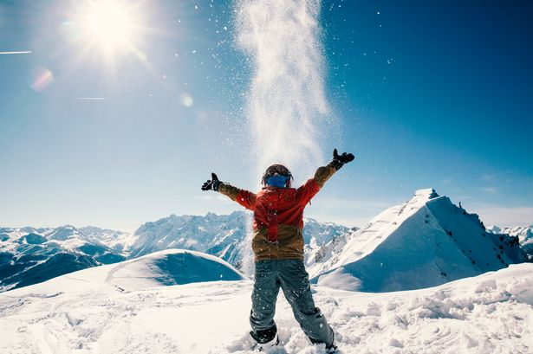
04.
CONCLUSION

Slide 15
+8-35%
c. $3.5m
$$$
ticket price increase supported by the model
more revenues implementing scenario 2
potential cost savings from closing runs
This is reflective of the superior offering provided by Big Mountain relative to its competitors.
through a predicted price increase of $1.99. This entails increasing the vertical drop by add a run to 150ft lower and adding a chair lift.
Closing 1 run can generate significant cost savings with minimal to no impact on price. Considering price impact, it is more beneficial to close 4 or 5 runs should the business decide to close 3.

Slide 16
SUMMARY & NEXT STEPS
Next steps
Big Mountain is superior to competitors in terms of facilities but offers tickets which are under-priced relative to its competitors.
Most valued facilities are: fast 4-person chairs, vertical drop, chair lifts and number of runs.
Potential data to include:
Number of tickets or visitors
Cost information
Geolocation data
Adult week
Consider adjusting ticket prices to capture higher value provided to customers
Consider closing 1 (min-no price impact) or 4-5 runs (price decrease similar to closing 3 runs)
Supplement findings with other business and qualitative analysis
Further analysis

Slide 17
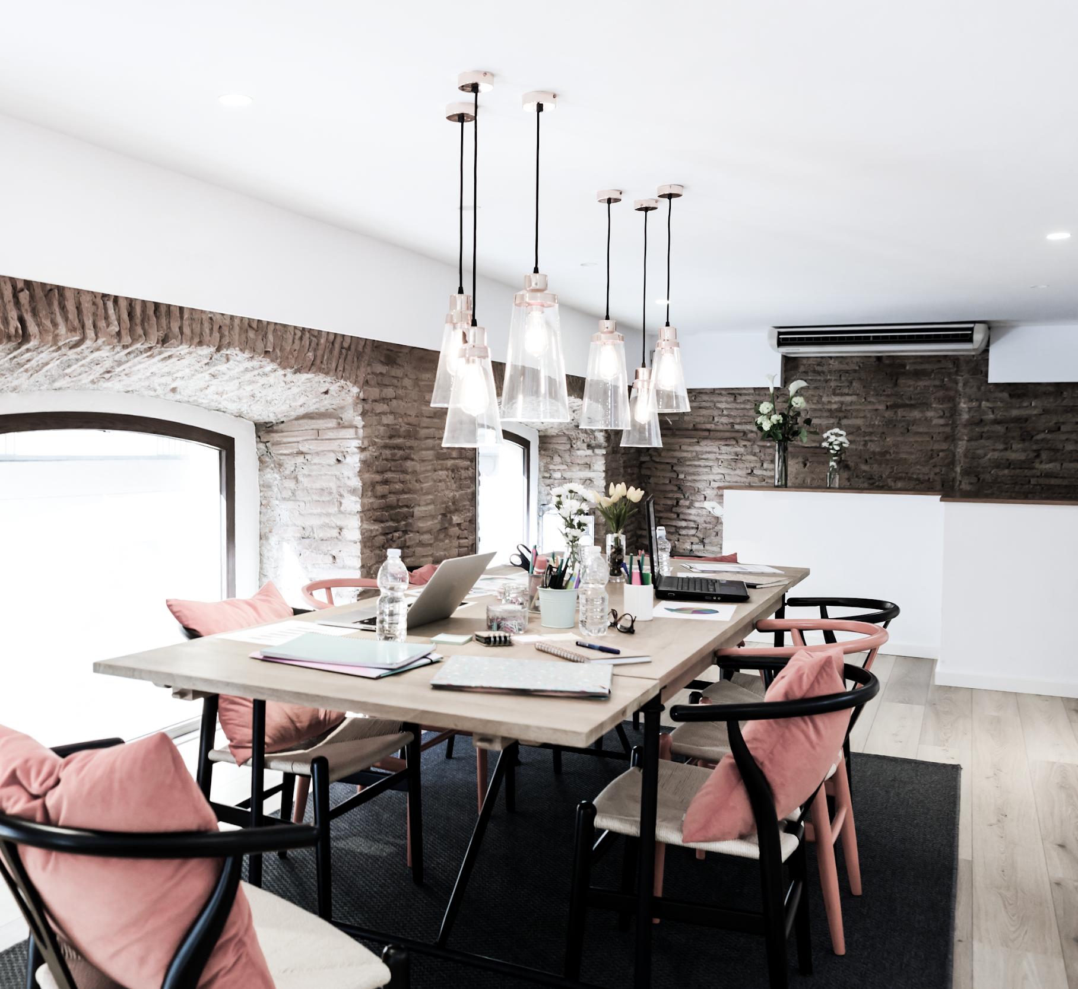
THANKS!
Do you have any questions?
Please keep this slide for attribution

Slide 18
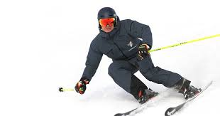
A.
APPENDIX
You can enter a subtitle here in case you need it

Slide 19
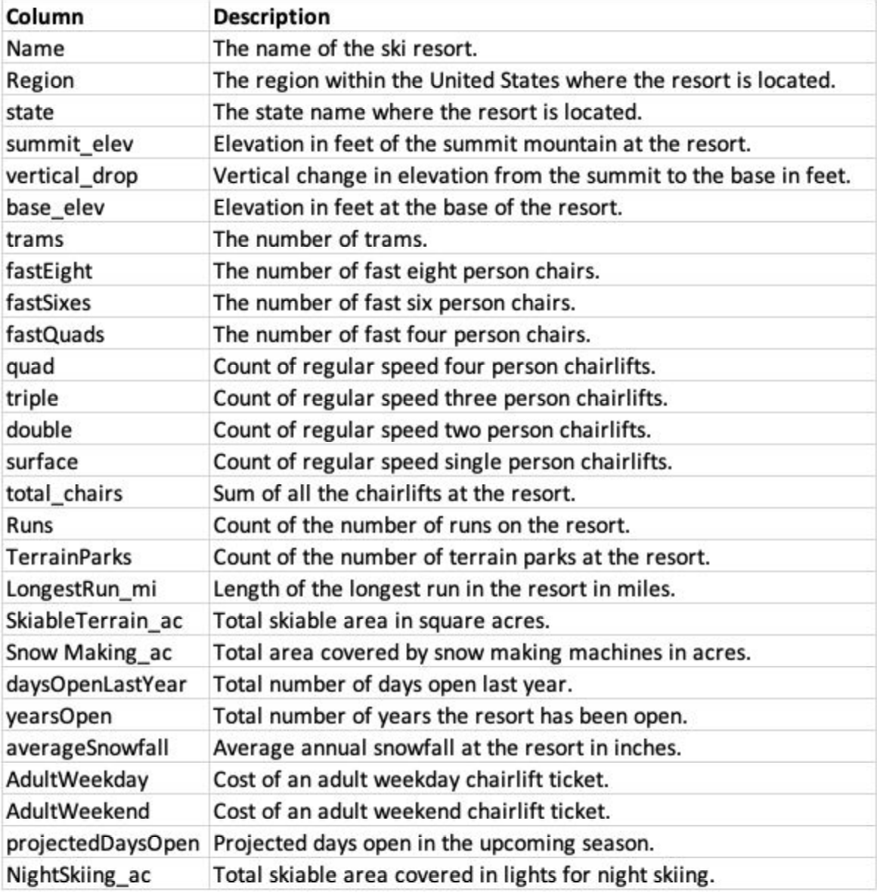
DATA USED

Slide 20
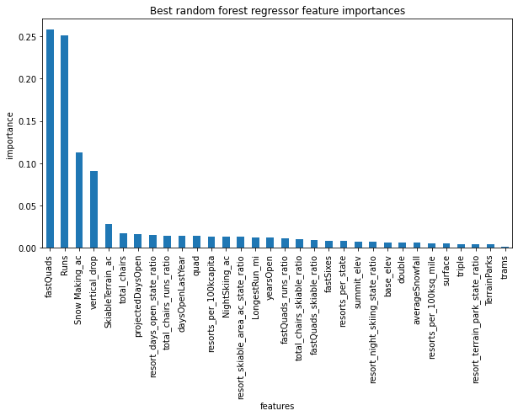
B. FEATURE IMPORTANCE – RANDOM FOREST

Slide 21
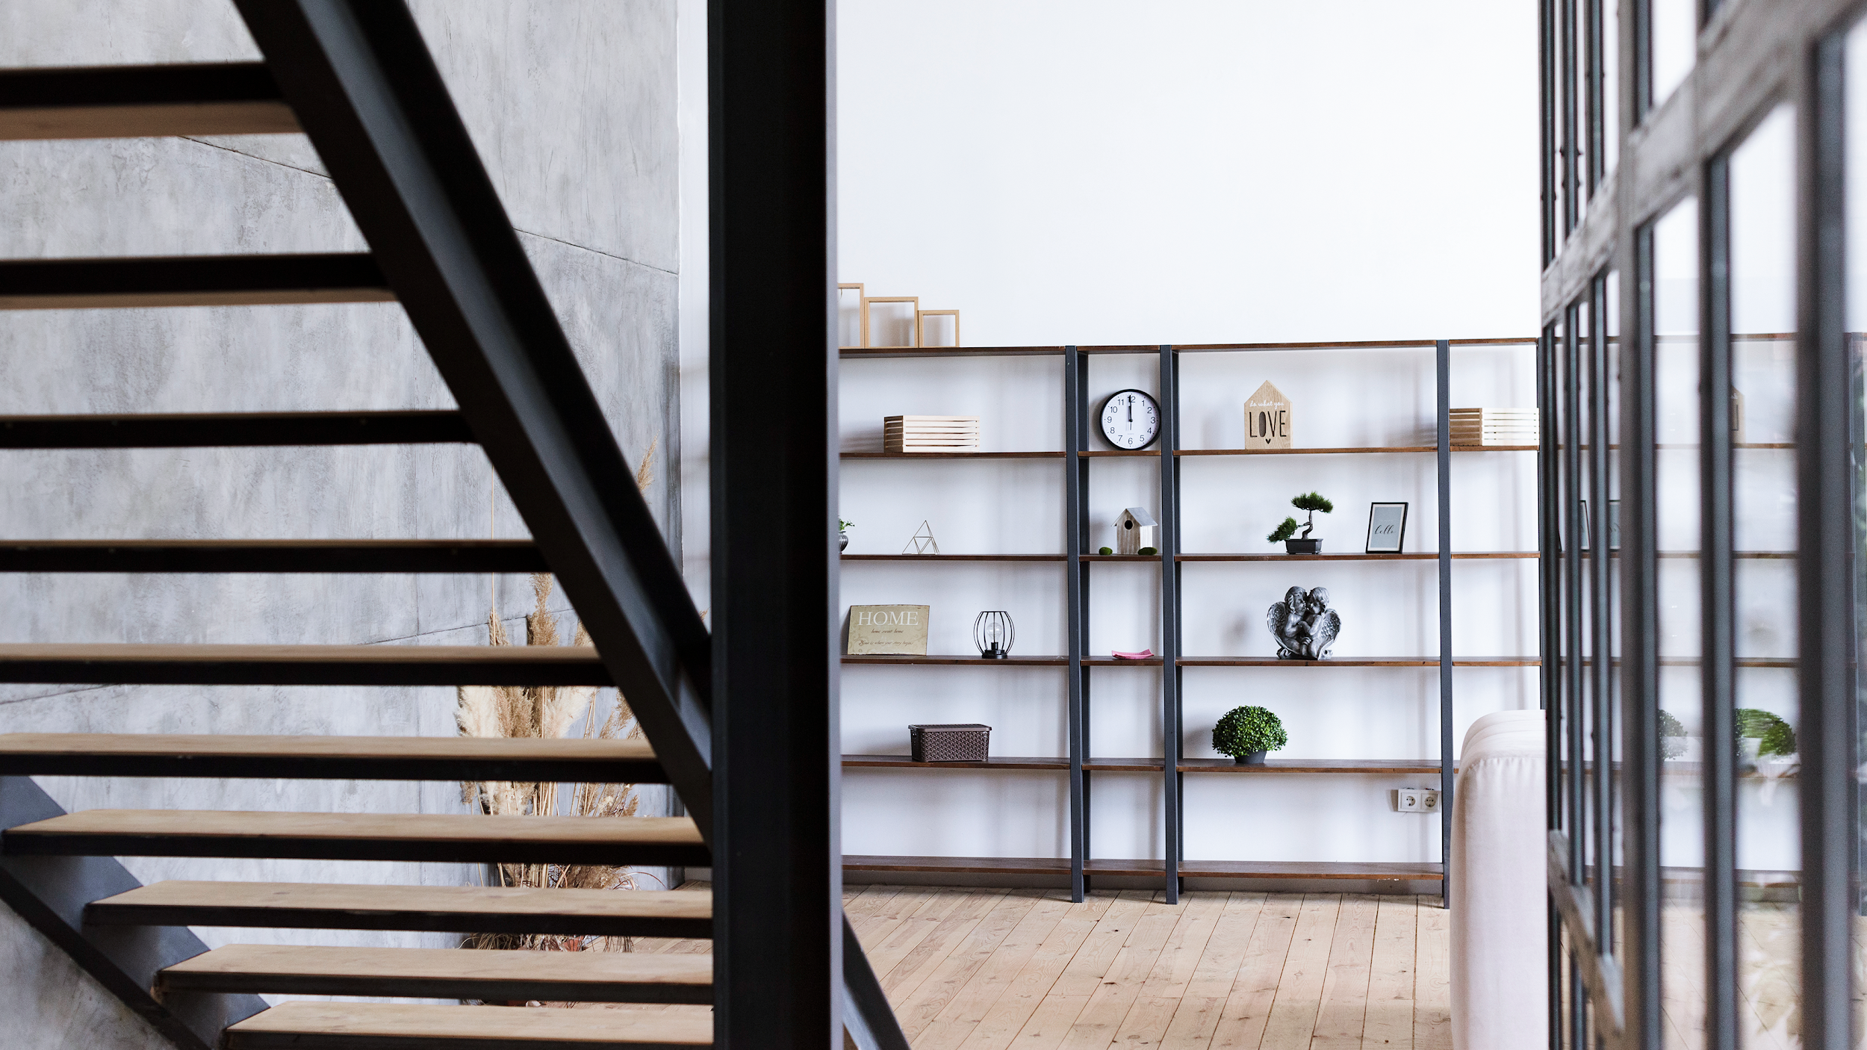
END.

